Slide 1
Todo: Graph emissions | Useful for observing how transport decreases emissions as these are assumptions for ct

Slide 2
Notes from energy stats workshop
Potential losses in evs beyond expected efficiency could be significant. This makes surveying more important, as well as potential reason to decrease efficiency?
Charging is expected to be ?? (the largest amount)
Heating in cold climates because engine doesn’t create heat
Taiwan imports parts and puts together their cars domestically?

Slide 3
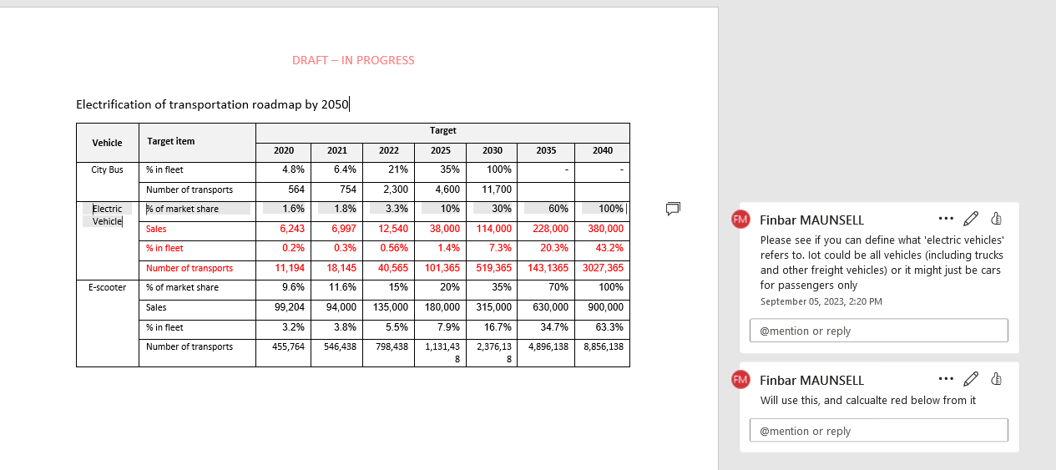
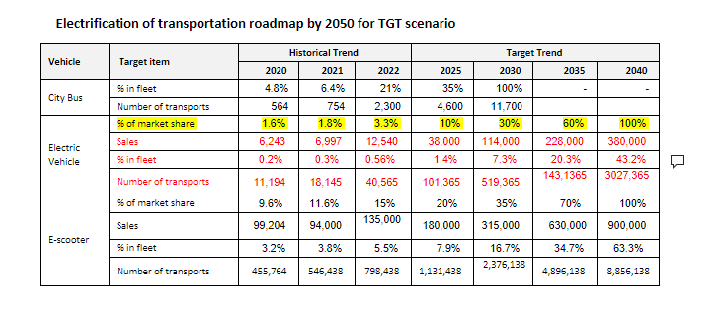

Slide 4
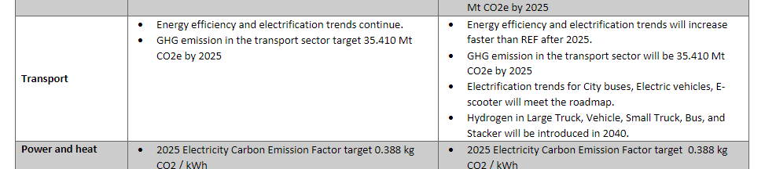

Slide 5
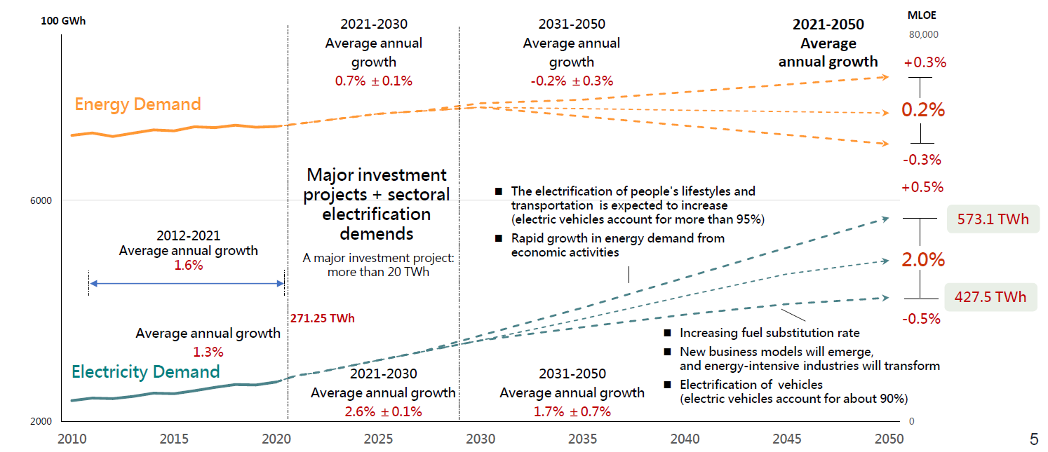
CT Government Key Regulation and Policies
2022 Net-zero roadmap

Slide 6
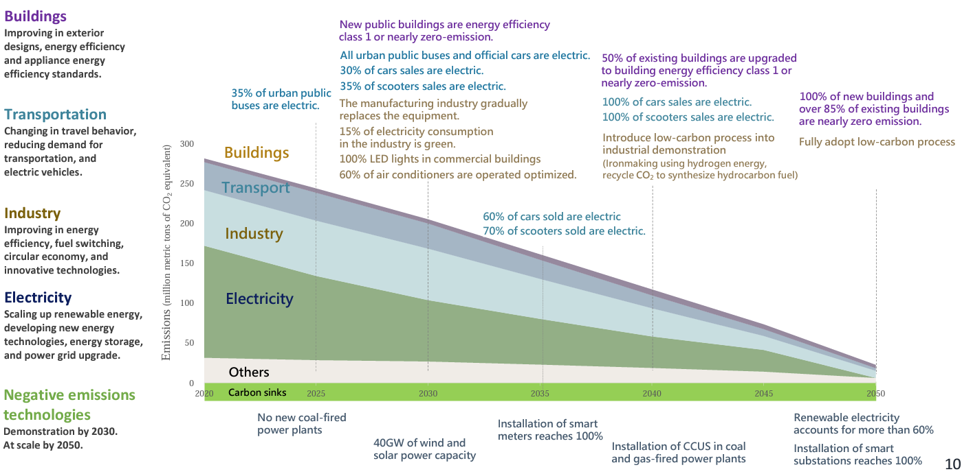
CT Government Key Regulation and Policies
2022 Net-zero roadmap

Slide 7
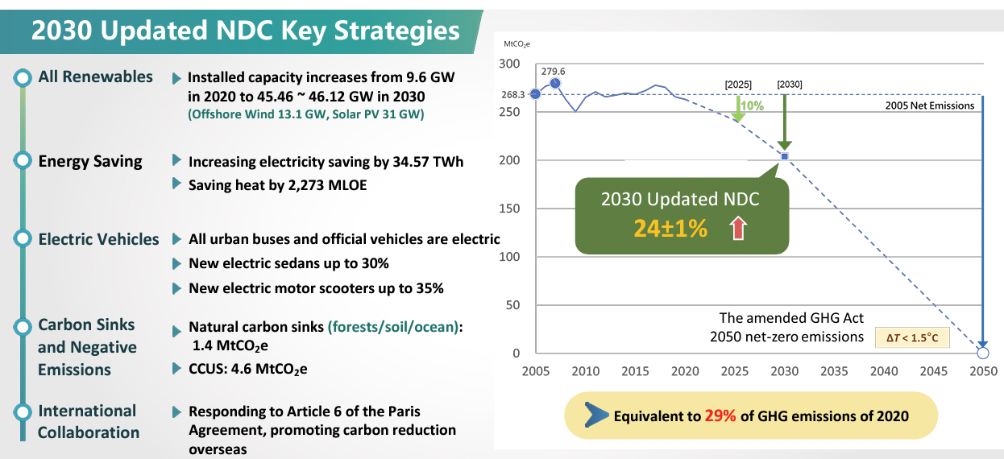
CT Government Key Regulation and Policies
2023 NDC Update (30X23~25)

Slide 8
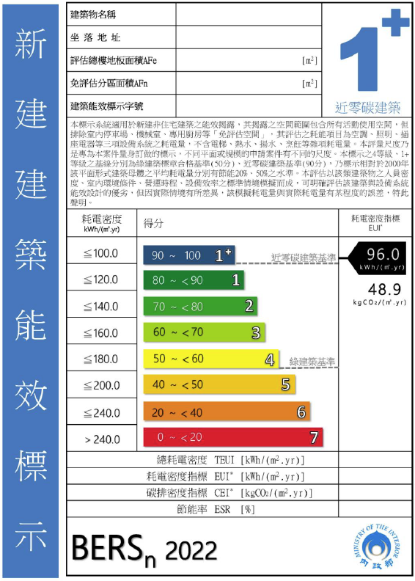
CT Government Key Regulation and Policies
12 Key Strategies for Net-zero
Industry | 50% of energy cons. of major energy users is included in ISO 50001 by 2025, 60% by 2030.
Building (Commercial) | 70% lighting are LED by 2025, 100% by 2030. 30% HVAC are optimal control by 2025, 60% by 2030. All new public building reach Level 1 or net-zero at BERS system Public building electric usage index (EUI) improve 15% from 2015 level by 2030.
Building (residential) | Residential building envelope performance increase 5% by 2025, 10% by 2030. 100% lighting on sale are LED by 2025 MEPS for Air conditioning , refrigeration are level 3 at current standards
Transport | Efficiency 2.5 tons light-duty trucks covered by energy efficiency management. Overall new transport improve energy performance by 30% Electrification 35% of city bus are eclectic-driven by 2025, 100% by 2030. 100% of government-owned vehicle are eclectic-driven by 2030 30% of vehicle on sale are eclectic-driven by 2030, 60% by 2035, 100% by 2040. 35% of scooter on sale are eclectic-driven by 2030, 70% by 2035, 100% by 2040.

Slide 9
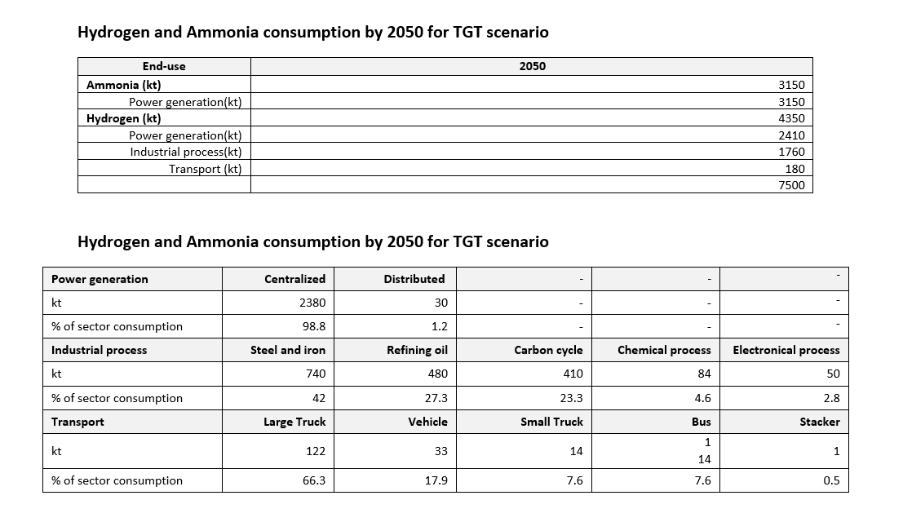

Slide 10
